Slide 1


Transcendence
October 2024

Slide 2
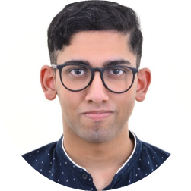

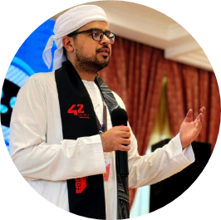

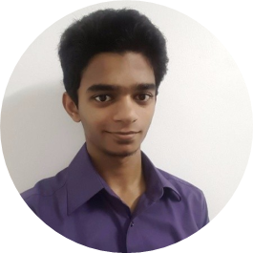
THE TEAM
Joe Shaju
Huong Bui Vu
Jafar Alwaheidi
Zahra Syyida
Shaik Mazin Bokhari
Website design
Setting up Django
Browser compatibility
Tournament
User Friends
ELK Stack
Logging
Microservices
Vault
ModSecurity
Database
User management
Basic Authentication
User Game History
2FA Authentication
Pong Game
Tournament
User Game History
Remote Authentication
JWT Token
Monitoring
Git Review

Slide 3
Introduction

Slide 4
Major Modules
Use a Framework as backend
Standard user management, authentication, users across tournaments
Implementing a remote authentication
Implement WAF/ModSecurity with Hardened Configuration and HashiCorp Vault for Secrets Management
Implement Two-Factor Authentication (2FA) and JWT
Infrastructure Setup for Log Management
Designing the Backend as Microservices

Slide 5
Minor Modules
Use a front-end framework or toolkit
Use a database for the backend
Monitoring system
Expanding Browser Compatibility
Server-Side Rendering (SSR) Integration

Slide 6
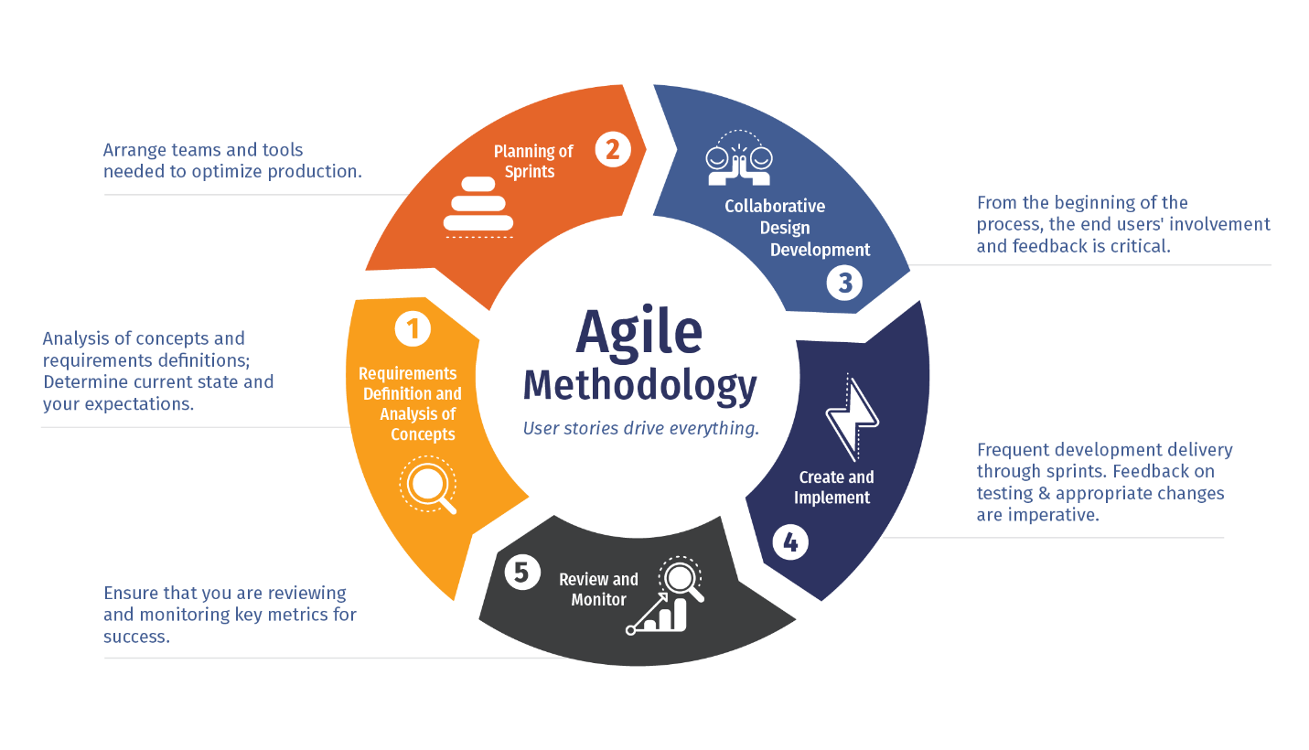
SDLC

Slide 7
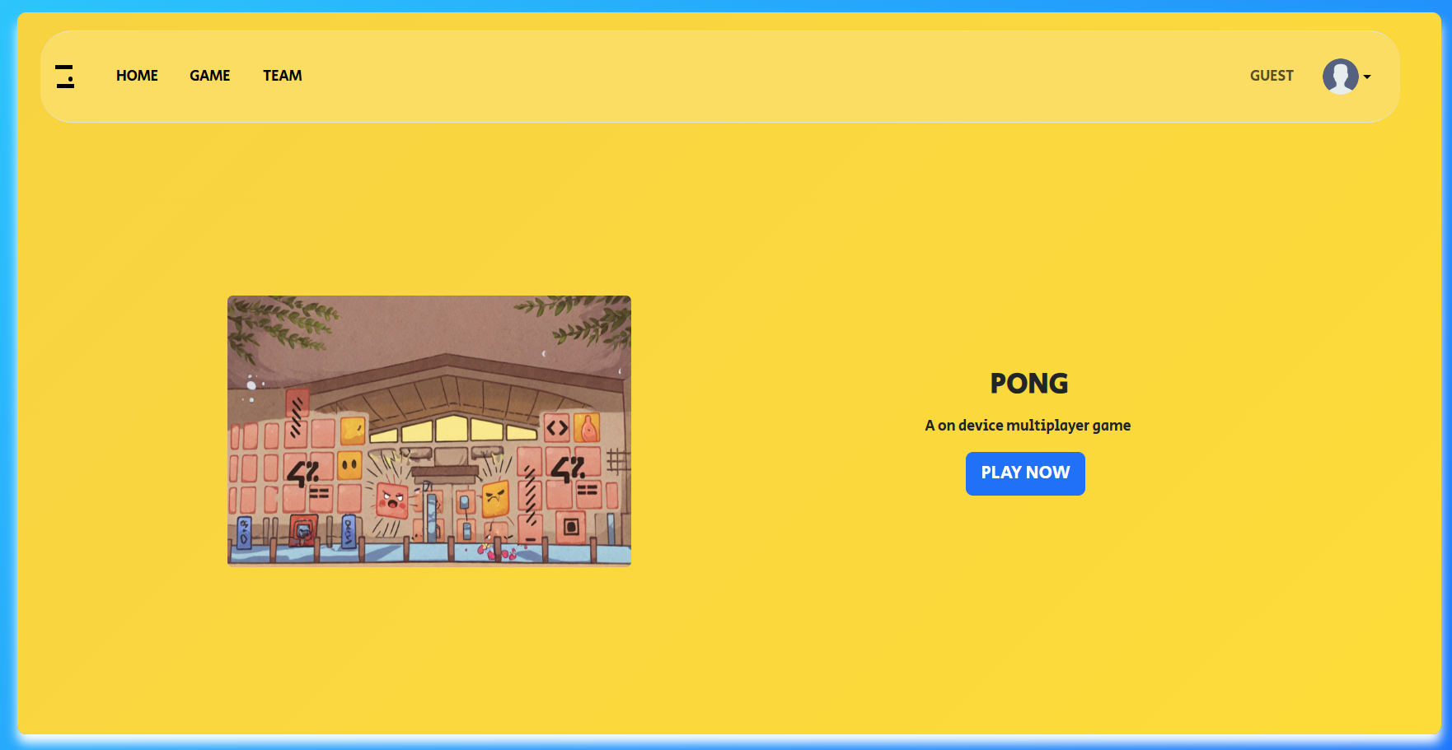
The Site
Notes:
This is our Site, running on Django as the backend and designed atop of bootstrap as the frontend framework

Slide 8
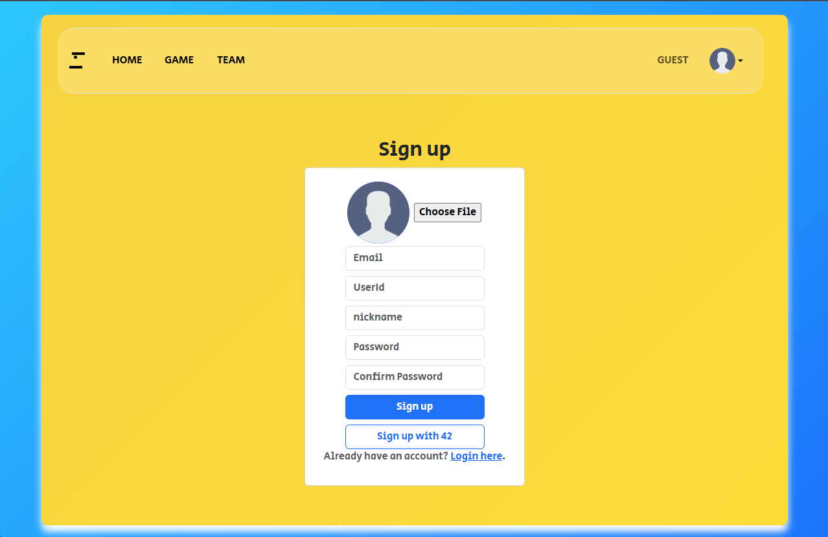
User Management and Registration
Notes:
New users can register their accounts by clicking the arrow near the guest icon and pressing sign up.
Add video logging in

Slide 9
Database
Django is connected to PostgresSQL
All user information are stored in the database
All passwords are hashed
2FA keys are encrypted

Slide 10
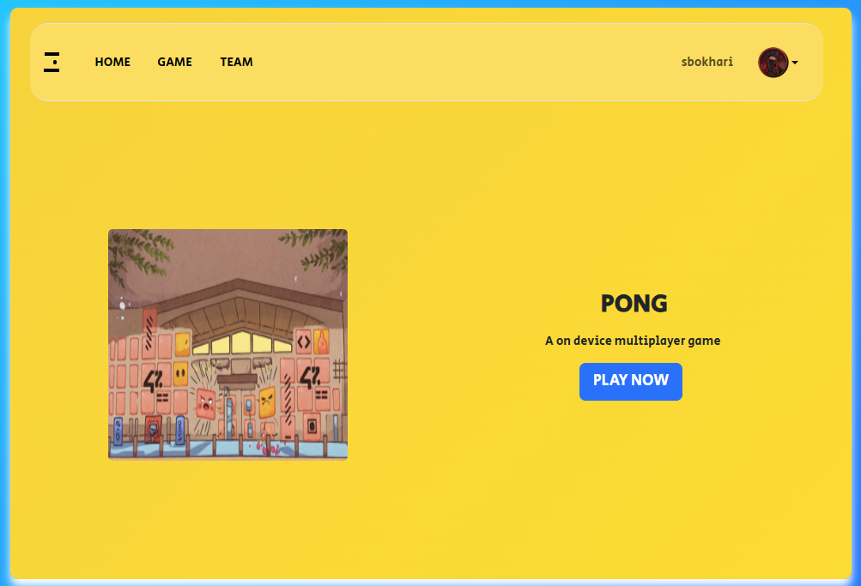
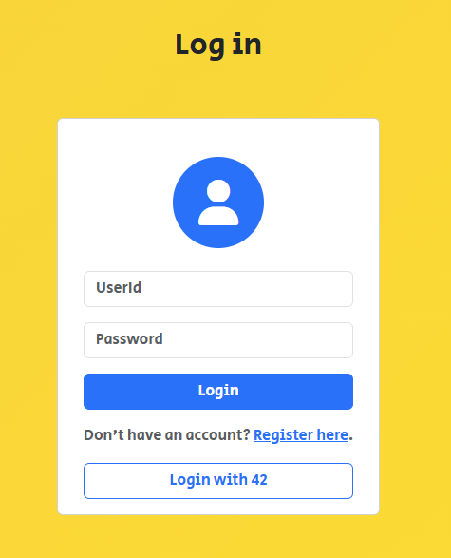
Signing In
Notes:
Once the user is registered, they can proceed to the login page and enter their credentials. After which they will be redirected to the home page and are able to confirm they are logged in with their username shown in the top right of the site.

Slide 11
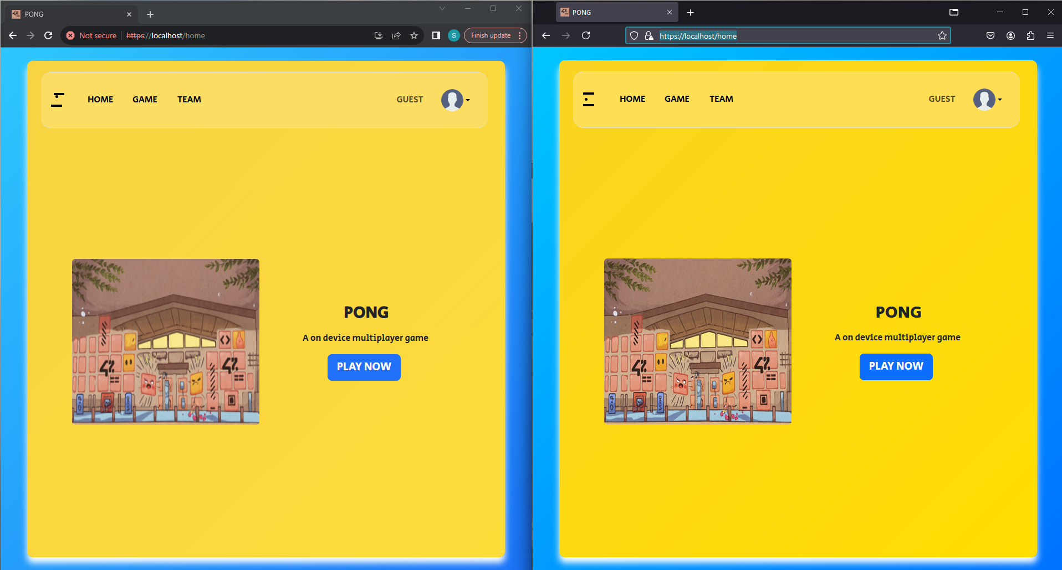

Multiple browser support
Notes:
Being designed on bootstrap, it allows the developer to easily accommodate for support for multiple different browsers. As it can be seen with Chrome and Firefox side by side

Slide 12
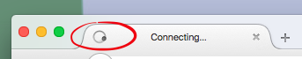
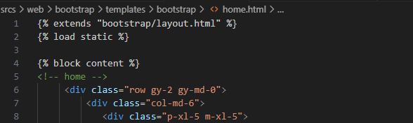
Server-Side Rendering
Notes:
Users can seamlessly explore the site without having their system being burdened. By sending the client the segment required for the next page, we are able to reduce load on the client system and network bandwidth resulting in a faster and snappier website experience

Slide 13
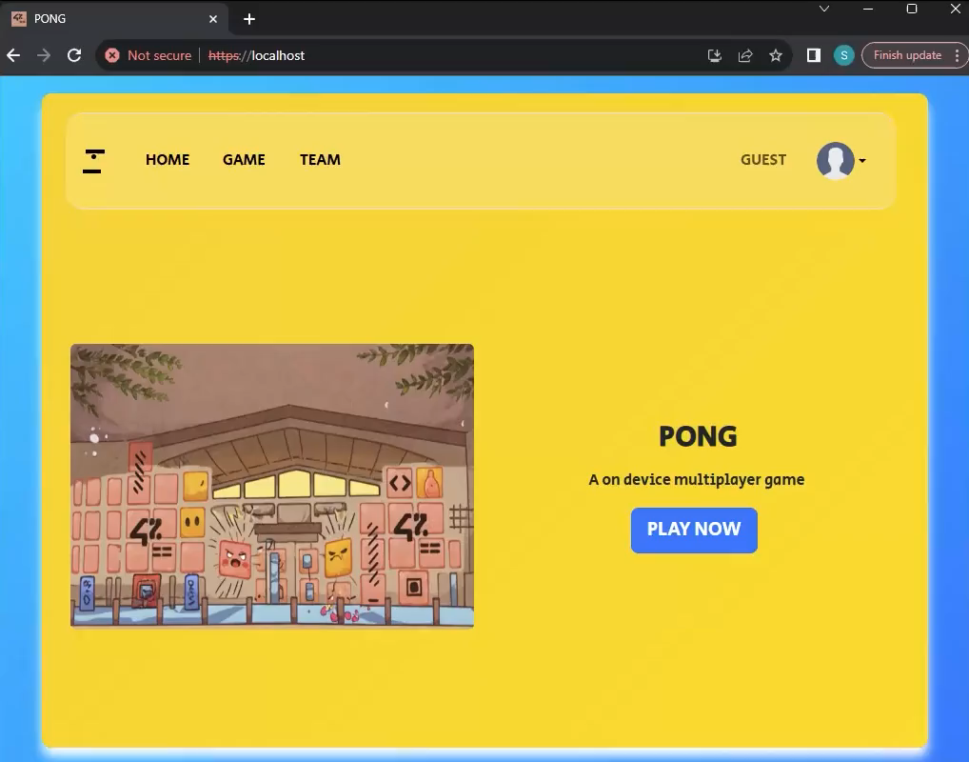
Notes:
Here you can see the user is able to switch between pages seamlessly nor any sign of the browser loading

Slide 14
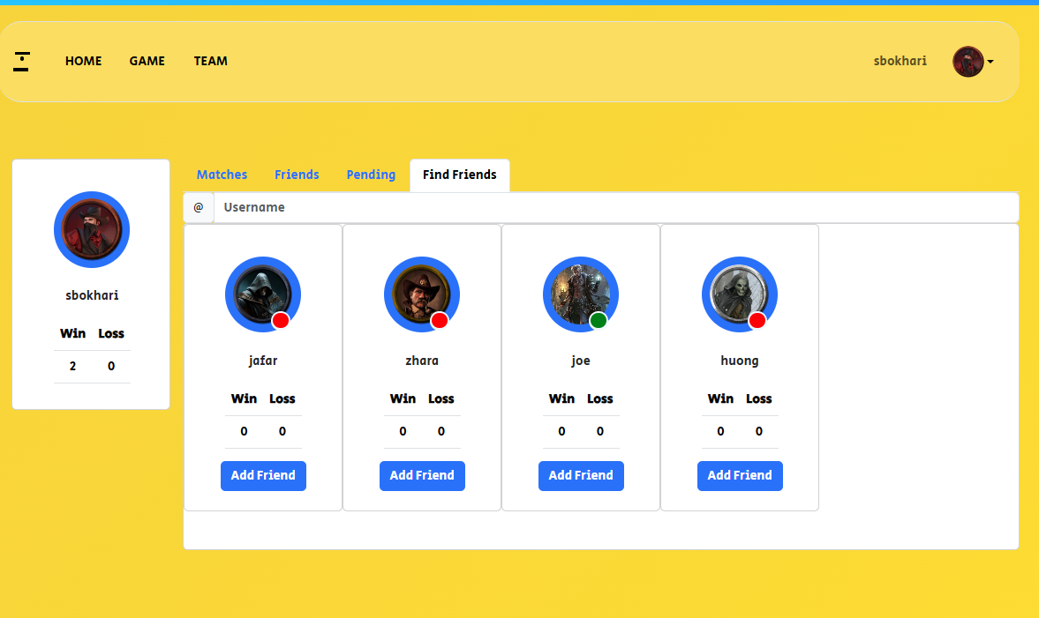
Find Friends

Slide 15
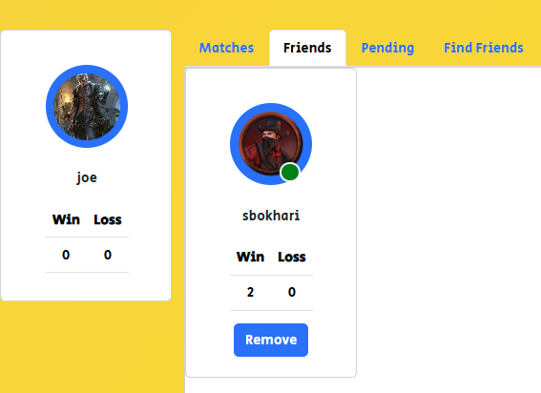
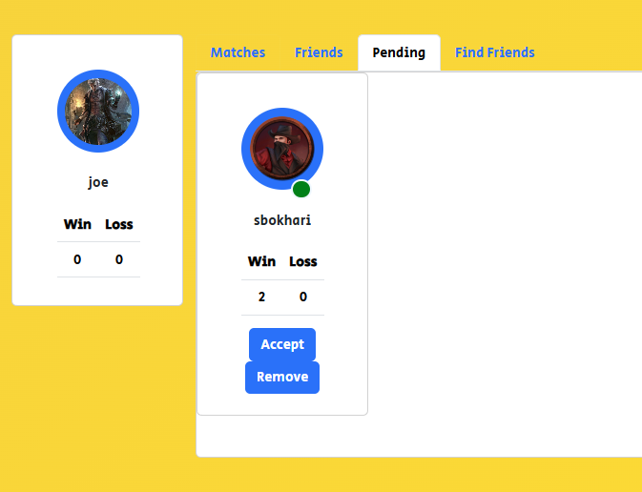
Accepting Friend Request

Slide 16
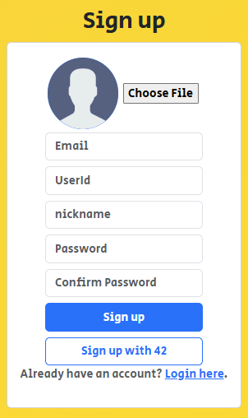
Remote Authetication
Notes:
But that’s not the only way to login, alternatively the user may decide to sign up or login using their 42 account. Upon clicking it

Slide 17
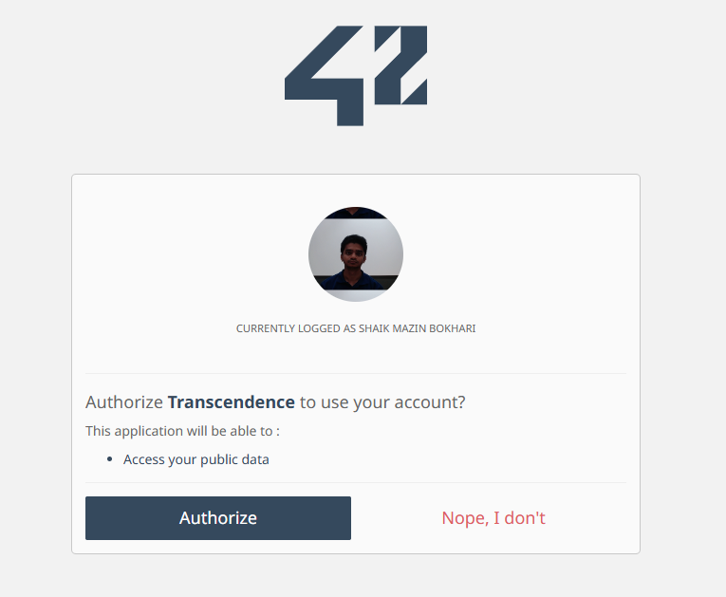
42 auth image
Notes:
The user will redirected to the 42 site. If already logged in, they will asked to authorize the site and will be redirected back to our site.

Slide 18
JSON Web Tokens
Log in to receive a refresh token
Private resources are secured using JSON Web token
All unauthorized access are denied or redirected to home

Slide 19
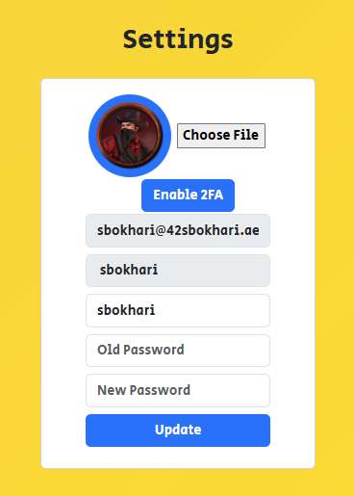
User Settings
Notes:
- Users can manage their profiles through settings.
- Key features:
- Upload avatar: Personalize profile with an image.
- Change password: Secure access by updating credentials.
- Add a nickname: Customize display name for games and interactions.
- Enable Two-Factor Authentication (2FA): Enhance security.

Slide 20
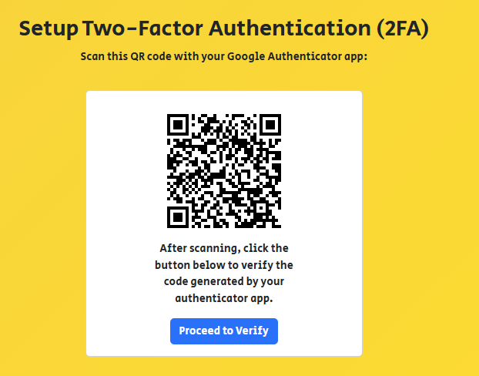
2 Factor Authentication
Notes:
Upon choosing to enable 2FA, the user is redirected to the setup page where they are asked to scan the QR code.

Slide 21
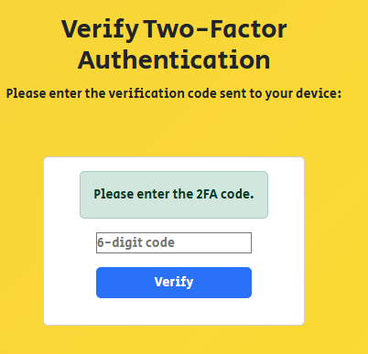
Notes:
Upon successfully verifying the code from an authenticator app the 2FA authentication will be enabled for the user. Where upon their next login will be required to enter 2FA to complete the login process

Slide 22
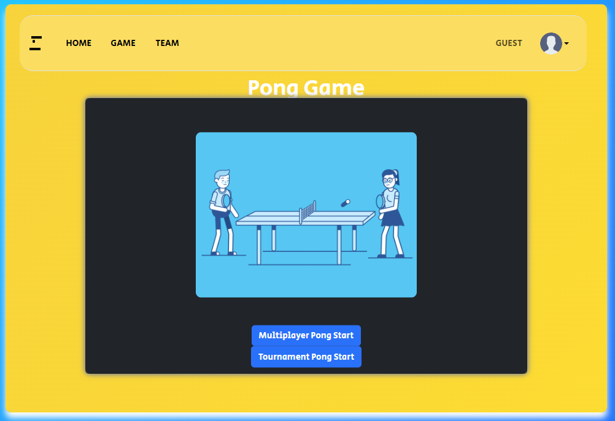
Pong
Notes:
Users can access the pong game and start with two different options

Slide 23
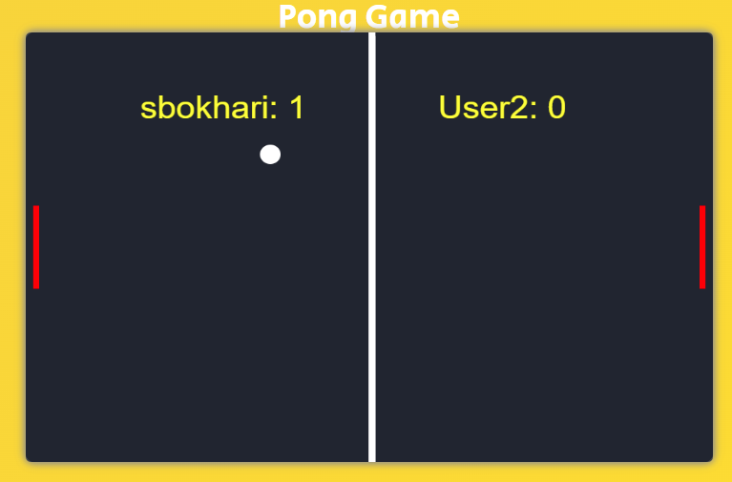
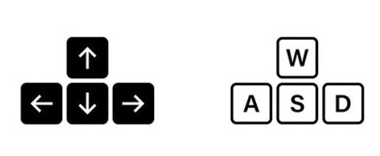
Multiplayer mode
Notes:
- Two-player game controls:
- User 1: Uses WASD keys.
- User 2: Uses arrow keys.

Slide 24
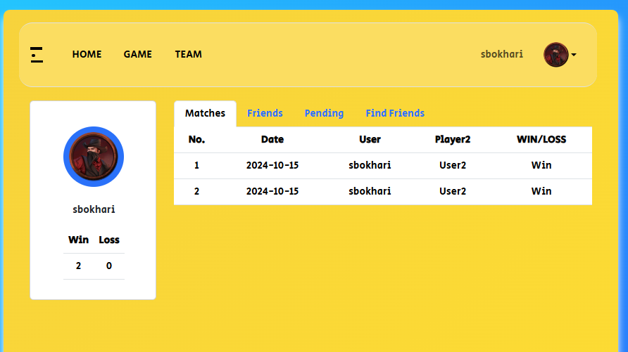
Match History
Notes:
Displayes wins and losses by date as well as total wins and losses.

Slide 25
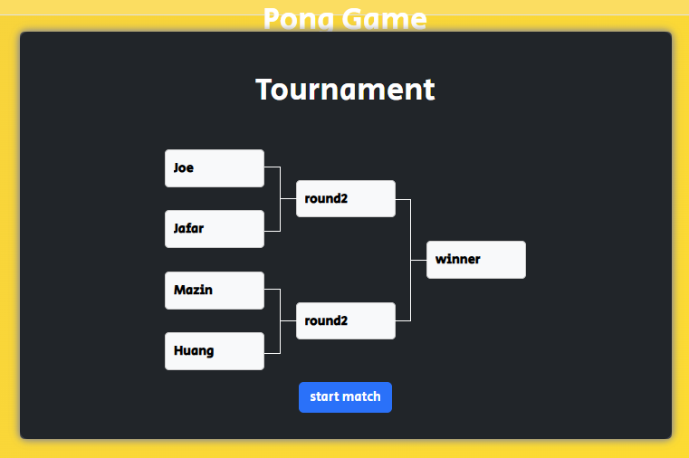
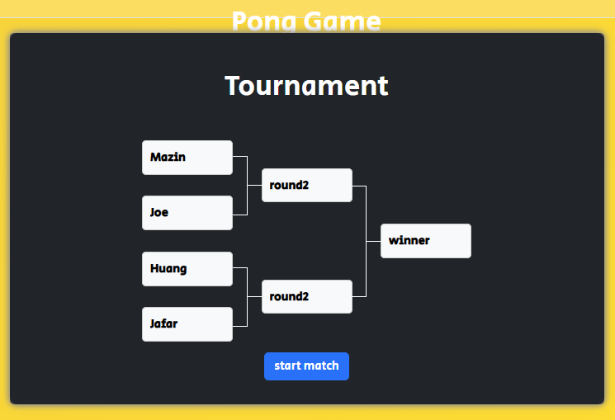
Tournament
Notes:
- Bracket system for organizing matches:
- after inputting Player aliases: Displays nicknames.
- after Randomization: Shuffle player positions in the bracket for fairness in matchmaking.

Slide 26
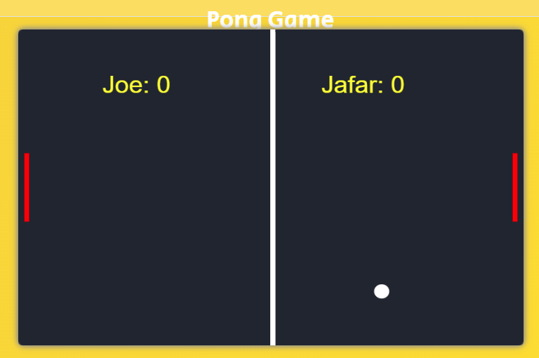
The Matches
Notes:
Each match continues till one player gets 10 points and then the winner of that match is displayed in the brackets

Slide 27
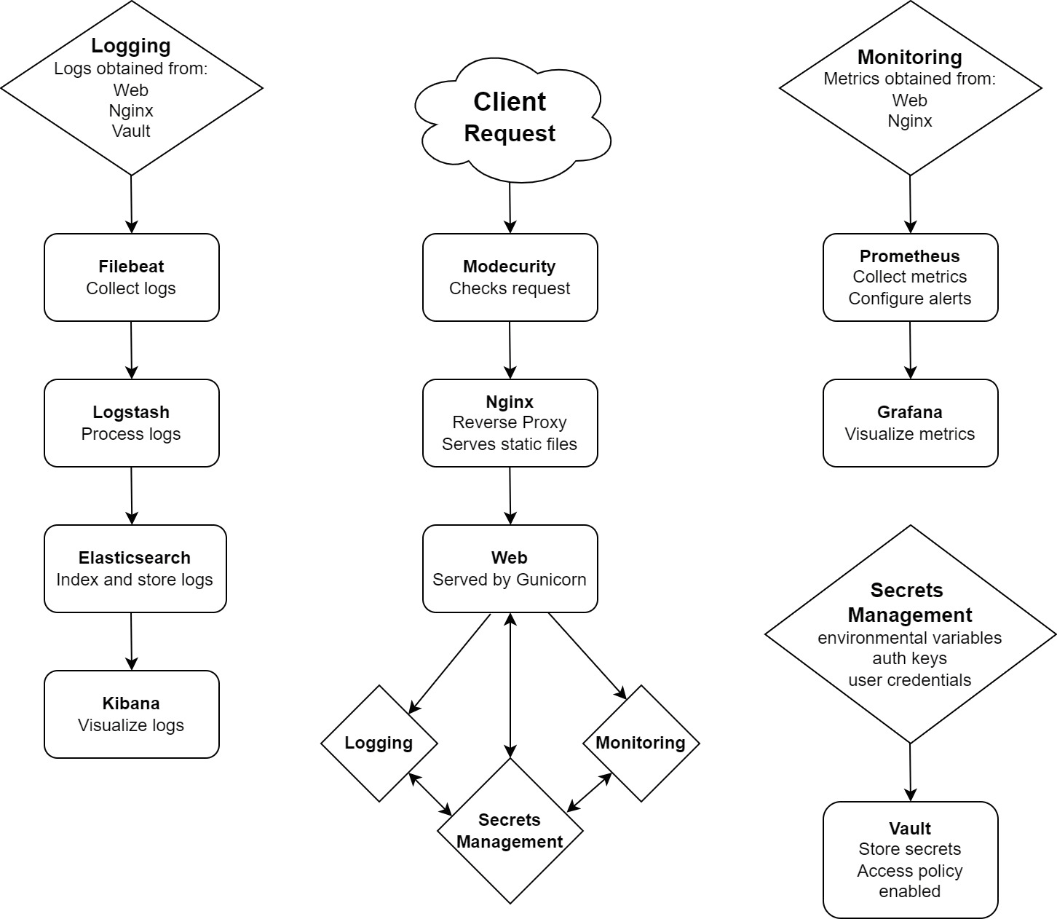
Logging and Monitoring

Slide 28
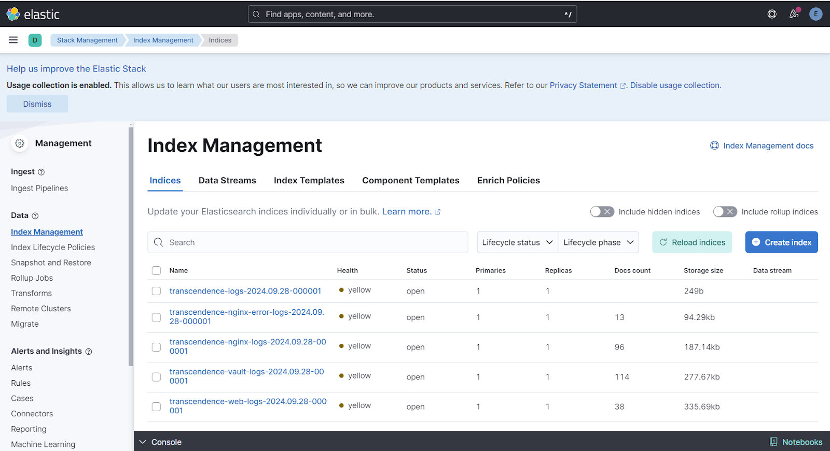
Logging

Slide 29
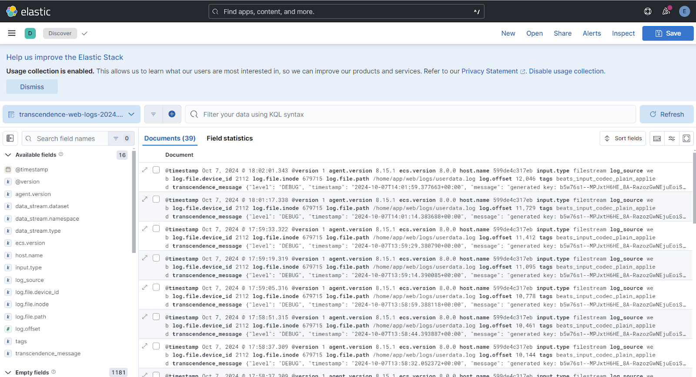

Slide 30
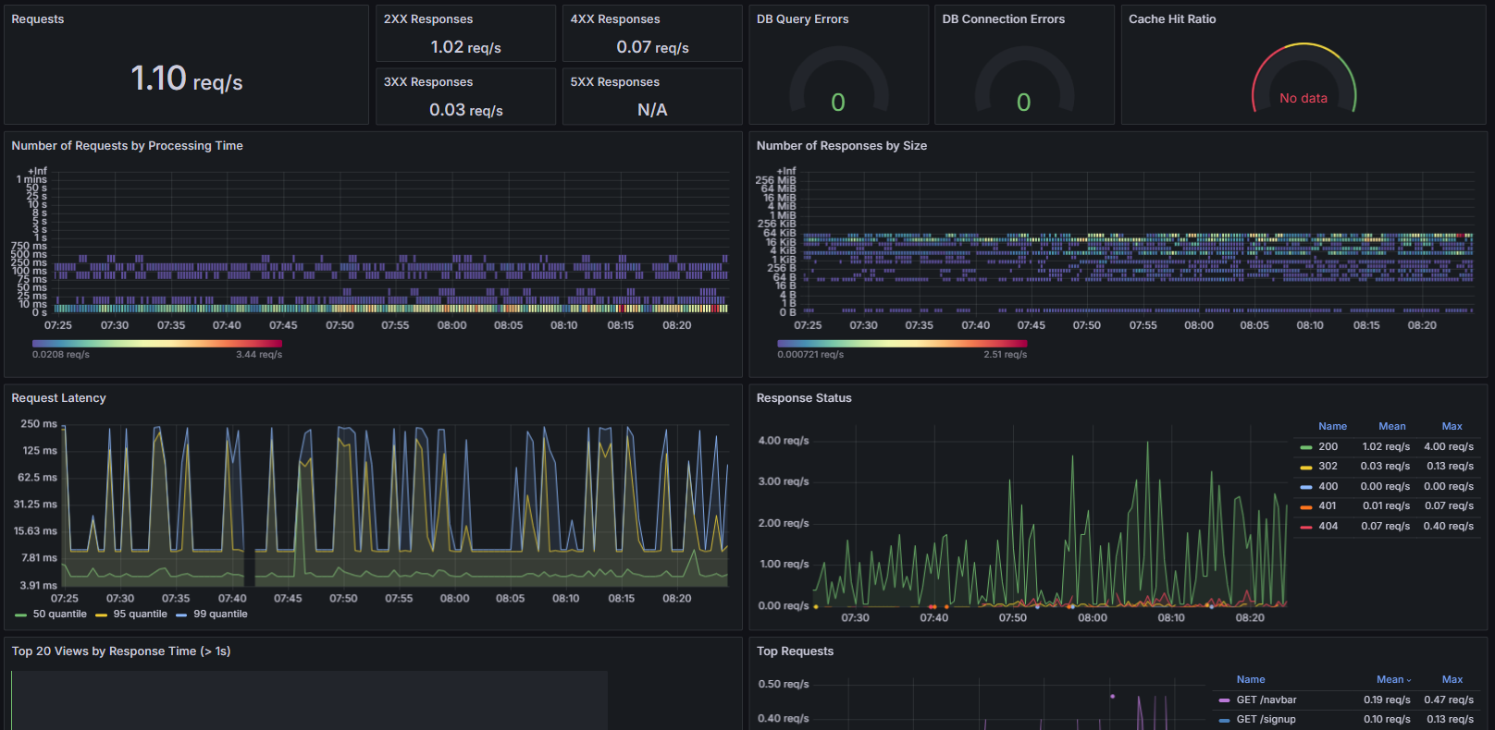
Monitoring

Slide 31
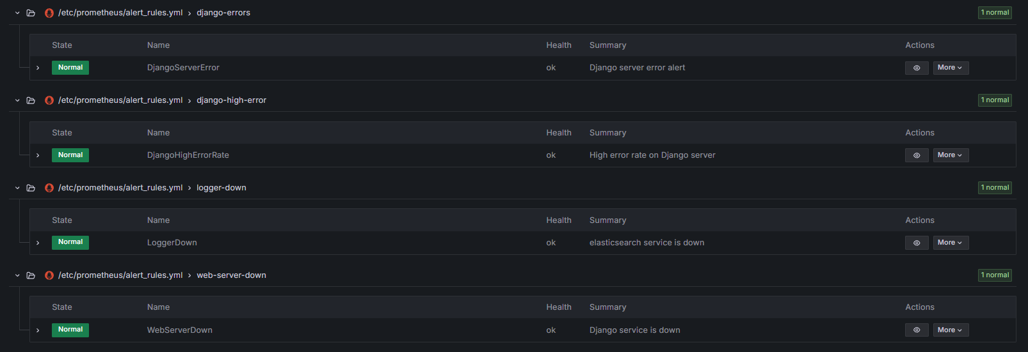
Alerts

Slide 32

Security
Site access using nginx as reverse proxy
Nginx is integrated with Modsecurity
Secret keys, encryption key, credentials stored in Vault
Notes:
The site is accessed through nginx, integrated with mod security to safeguard the server. Vital keys required for the operation of the sites and other services are stored in the vault to maximize protection and cant be access without prior unsealing.

Slide 33
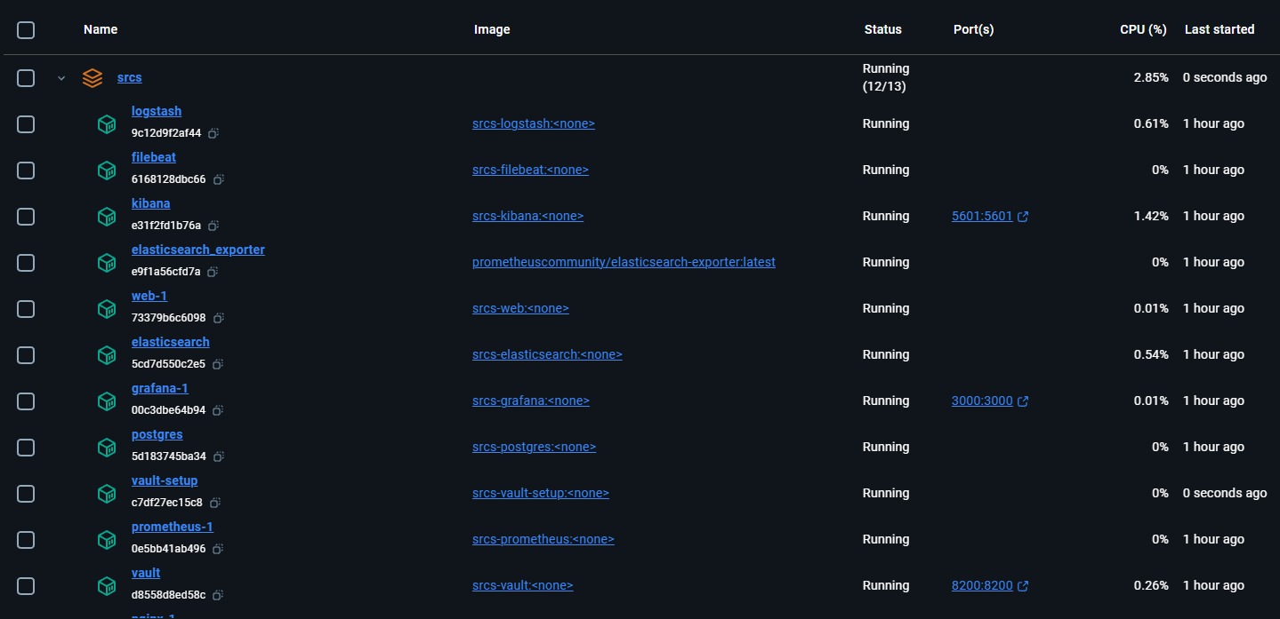
Microservices
Notes:
We separated each of our services from into different containers. This allowed us to collaborate more easily while also increasing the overall reliability of the entire site while also increasing the security.

Slide 34
Limitations
Lack of online gameplay support
Tournaments are limited to 4 players
Game cannot be played on mobile device
Lack of AI Pong opponent
Users are unable to chat with each other
Notes:
Add performance limitations?

Slide 35
Future Improvements
Online support to the game
Customizable Speed
Chat functionality
More Alert triggers
Means to send Alerts to admins
Cloud Vault unsealing
Better Animation

Slide 36
Thank you

